Slide 1
Analyzing Store Return Rate with Machine Learning Models
Siming Su, Jiayu Hu, Sameera Boppana
Northwestern

Slide 2
Background
In the rapidly evolving retail landscape, where e-commerce has significantly altered consumer behavior, the daily return rate at department stores like Dillard's has become an increasingly important metric. This rate, which indicates the frequency of returned products, offers critical insights into consumer satisfaction, purchasing trends, and inventory efficiency. In an age where physical stores compete with the convenience of online shopping, understanding the return rate is vital for maintaining customer loyalty and managing stock levels effectively. It reflects on the success of a store's product selection, pricing strategies, and overall customer experience.

Slide 3
Research Question
Goal: In this project, we would like to predict the return rate for each store per day.
Benefits of this model:
Better Inventory Management
Precise Financial Forecastings
Well-rounded Customers insights

Slide 4
Project Outline
EDA
SQL Query
Data Cleaning
Data Visualization
Feature Engineering
Create New Features
Feature Correlation
Modeling
Linear Regression
Random Forest
LSTM
ROI

Slide 5
EDA
Northwestern

Slide 6
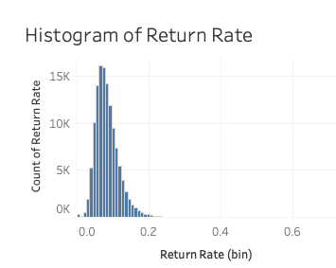
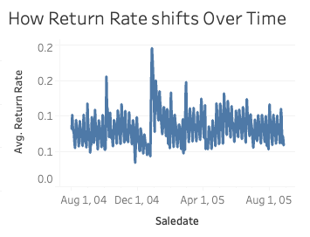
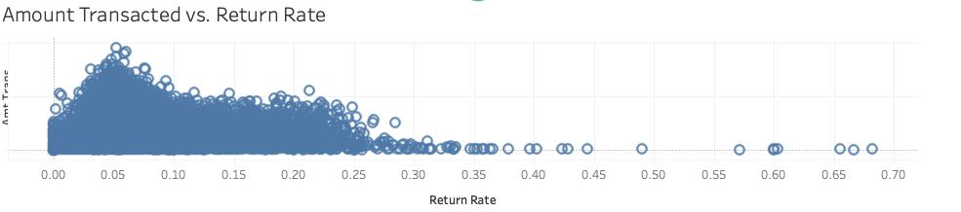
Return Rate

Slide 7
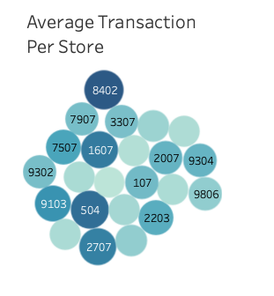
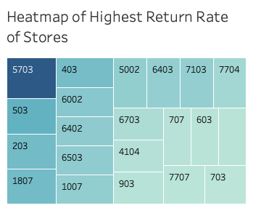
Store
The store with the highest Return Rate is 5703
The store with the highest average transaction is 8402

Slide 8
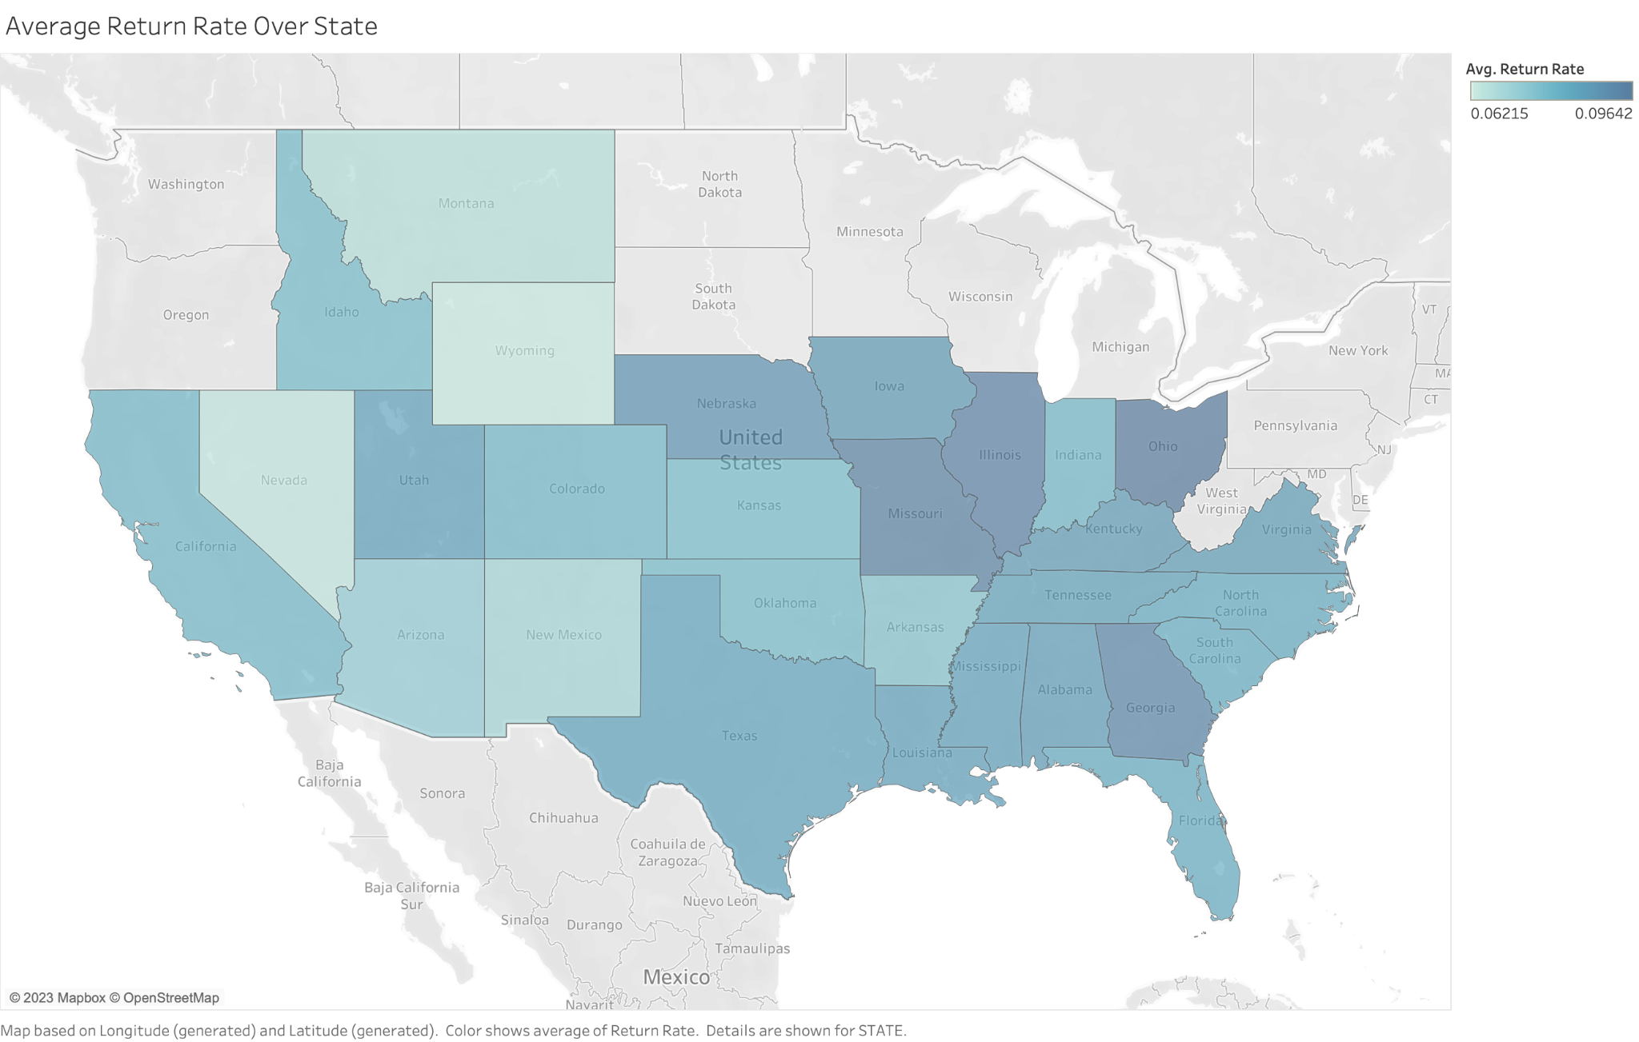
Return Rate VS. State
Insight:
- The East Side of United State has higher average return Rate Compared to the West.
- Ohio, Illinois, Missouri and Georgia has the highest return rate.

Slide 9
Feature Engineering
Northwestern

Slide 10
Data Preparation
Additional features we added:
Previous Day Return Rate: Short-term indicator, reflects immediate past performance.
Previous Week Return Rate: Captures weekly trends, smoothing out daily anomalies.
Previous Month Return Rate: Provides insight into longer-term trends and monthly cycles.
Previous Day AmtTrans: Shows the financial performance of the previous day.
Last 30 Days Trans: Provides insight into monthly business trends.
Last 30 Days AmtTrans: Reflects the store's recent revenue performance.

Slide 11
Features (Final List)
Previous Day Return Rate
Previous Week Return Rate
Day
NumTrans AvgPrice
Previous Day Trans
Last 30 Days Trans
Month
DiscountSalesCount
Previous Month Return Rate
AmtTrans
Previous Day AmtTrans
Quarter

Slide 12
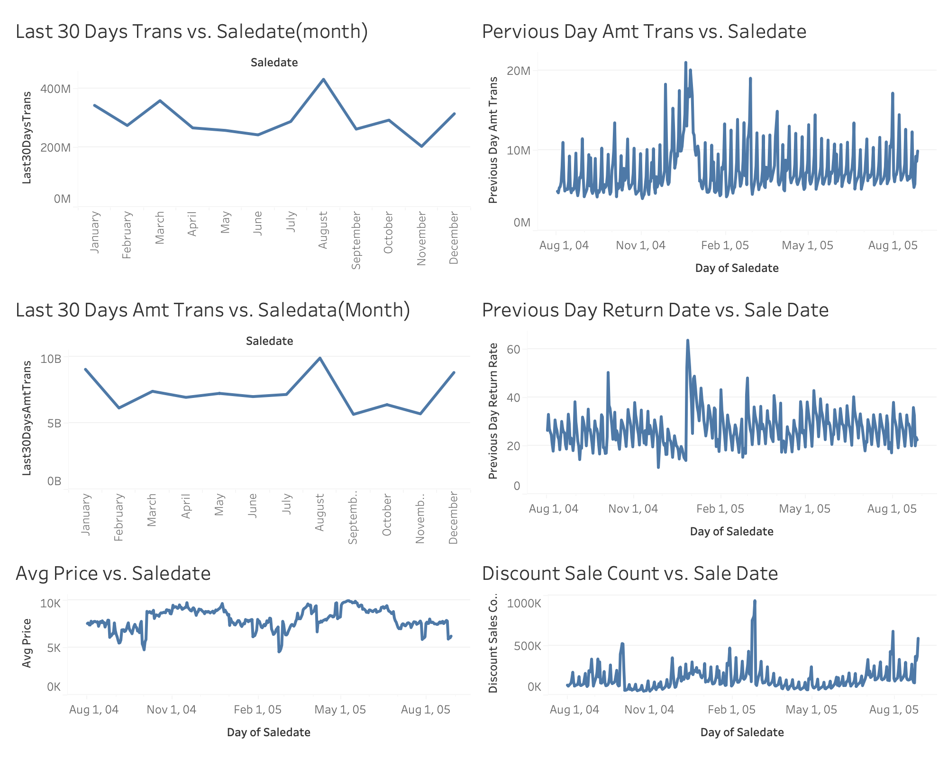
Visualization
Transactions and sales at the month and daily level

Slide 13
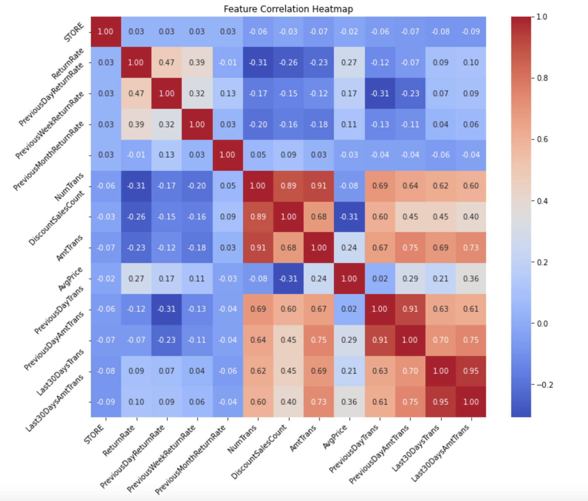
Feature correlation
Correlations between the various predictor variables
Insight:
Most of the temporal variables are highly correlated, which is expected.
Return rate seems to not have strong correlation with any one of the variables.

Slide 14
Modeling
Northwestern

Slide 15
Model Architecture and Significance
Model:
'ReturnRate' ~ 'PreviousDayReturnRate' + 'PreviousWeekReturnRate' + 'PreviousMonthReturnRate' + 'NumTrans' + 'DiscountSalesCount' + 'AmtTrans' + 'AvgPrice' + 'PreviousDayTrans' + 'PreviousDayAmtTrans' + 'Last30DaysTrans'+ 'Last30DaysAmtTrans' +'Month' + 'Quarter' + 'Day'
Significant Variables:
['PreviousDayReturnRate', 'PreviousWeekReturnRate', 'PreviousMonthReturnRate', 'NumTrans', 'DiscountSalesCount', 'AmtTrans’, 'AvgPrice', 'PreviousDayTrans', 'PreviousDayAmtTrans', 'Last30DaysTrans', 'Day']

Slide 16
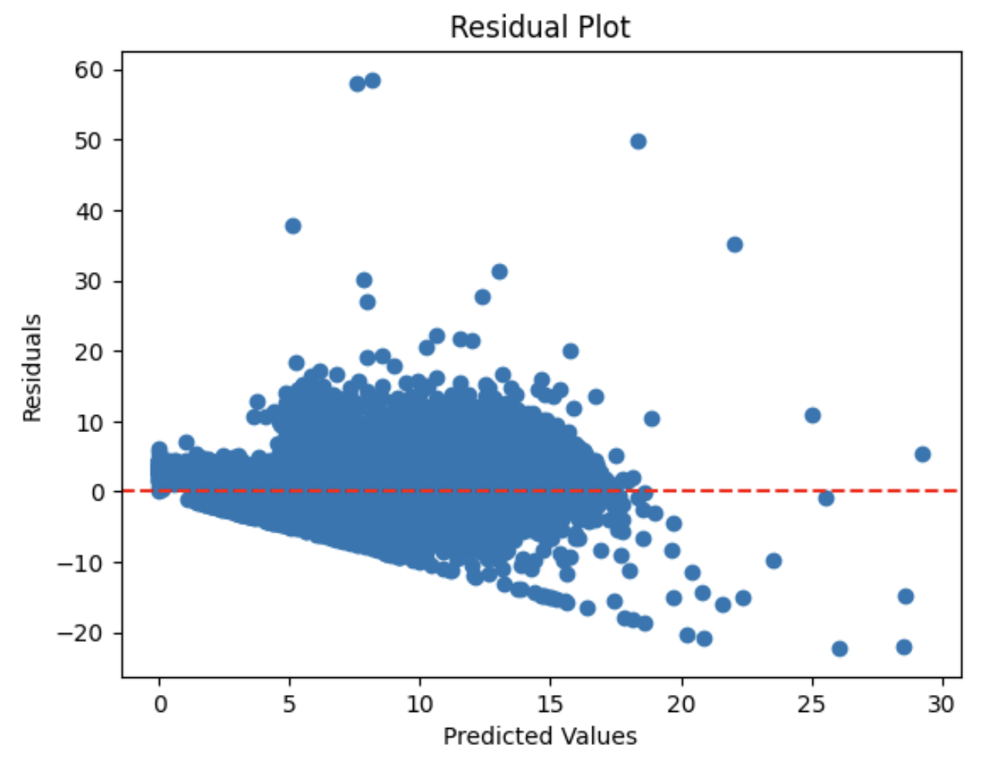
Linear Regression Metric
Training R Square: 0.455
Training MSE: 5.74 (in terms of %)
Test R Square: 0.45
Test MSE: 5.91 (in terms of %)
Indicator of heteroskedasticity

Slide 17
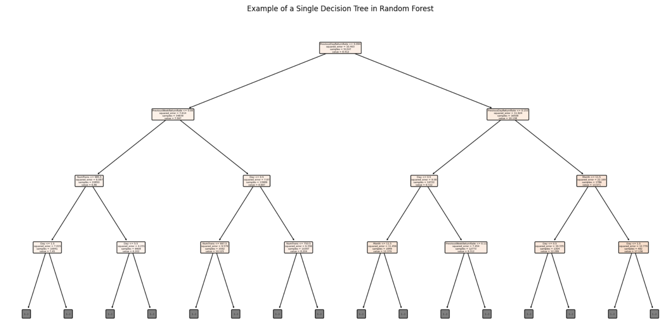
Random Forest
Parameters:
N_estimators: 100
Max_depth: 20
Min_samples_split: 2
Min_samples_leaf: 1

Slide 18
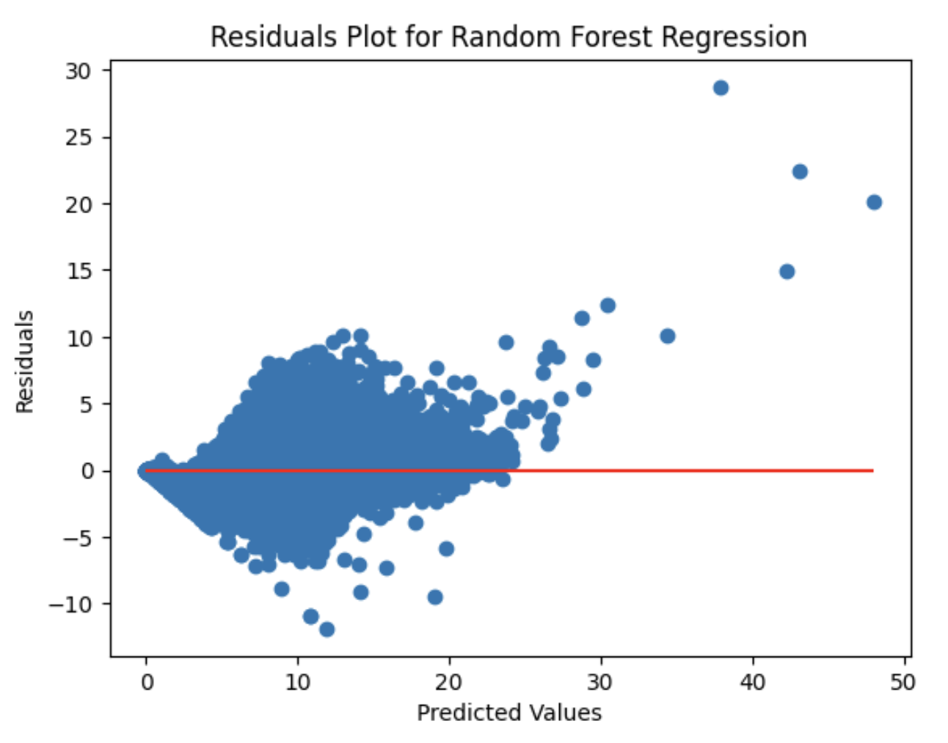
Random Forest Metric
Training Accuracy:
Training MSE: 2.52
Training R^2: 0.76
Test Accuracy:
Test MSE: 4.63
Test R^2: 0.57
Residual plot looks much better compared to Linear model one

Slide 19
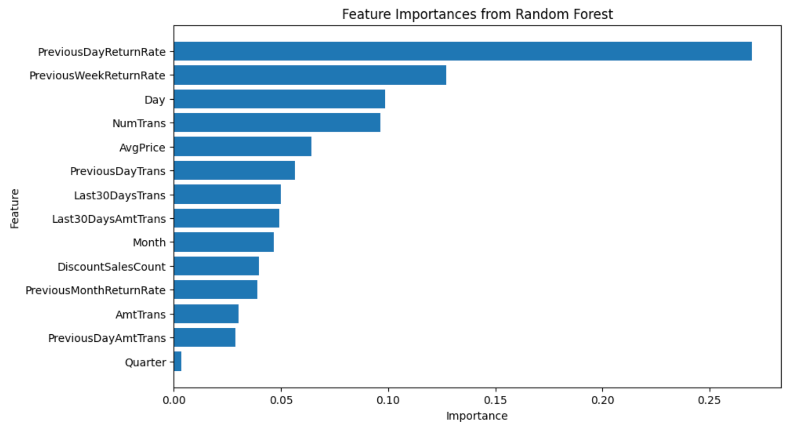
Feature Importance
Business Insight:
Previous Day/week return rate is an indicator of next day/week return rate.
Number of transaction is associated with return rate
Selling in different Quarter does not affect return rate much.

Slide 20
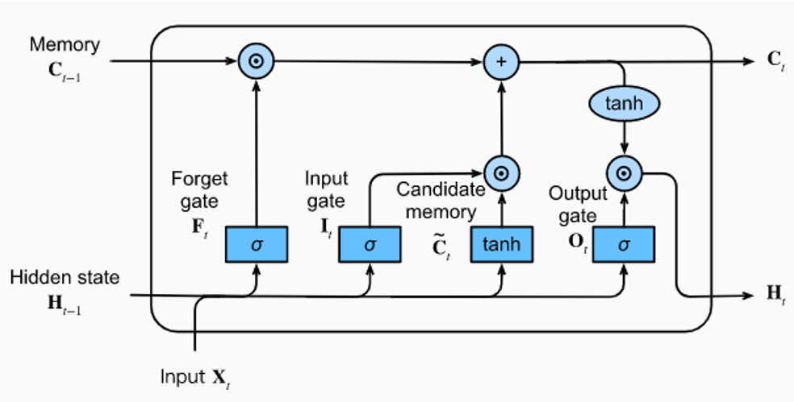
LSTM (Long short-term memory)
Hyper-Parameters:
Num_layer: 3
Hidden_size: 128
Learning Rate: 0.0001
Num Epochs: 50
Batch Size: 64

Slide 21
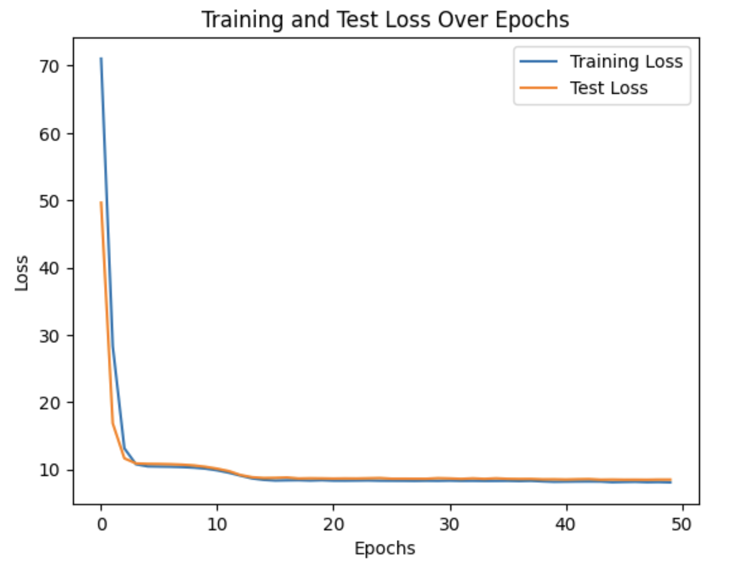
LSTM Metric
Training Accuracy:
Training MSE: 8.3113
Test Accuracy:
Test MSE: 8.6601

Slide 22
ROI
Northwestern

Slide 23
Model Selection
Model Candidate: Random Forest
Reasons:
Lowest Training and Testing RMSE (Training: 2.52, Test: 4.63)
Higher Explanation level with Feature Importance Plot
Best Residual Plot performance

Slide 24
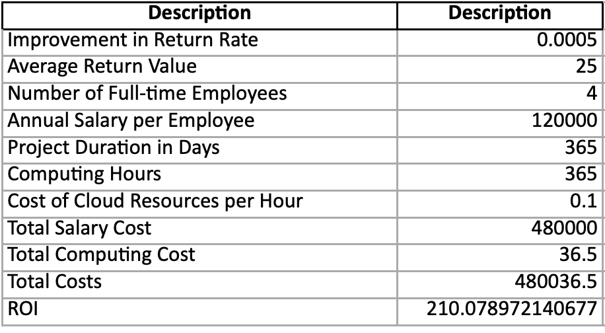
ROI Analysis

Slide 25
Thank you
Northwestern

